Slide 1
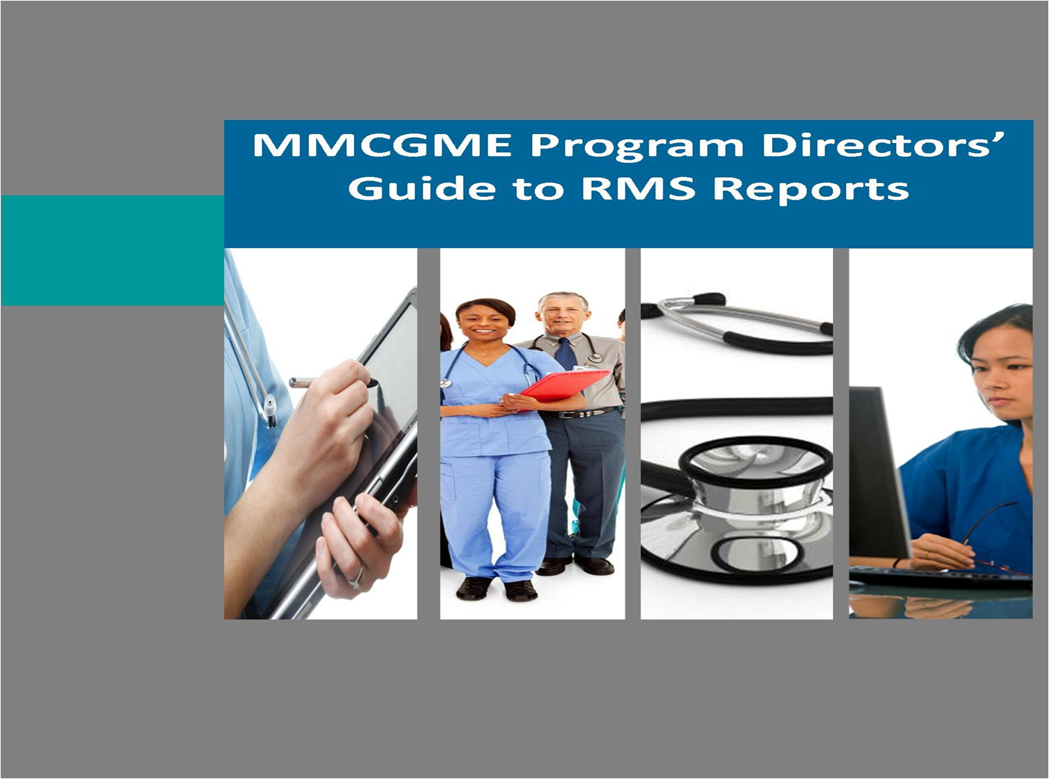
Legislative Health Care Workforce Commission
Graduate Medical Education
Troy Taubenheim
Metro Minnesota Council on Graduate Medical Education
August 25, 2014
MMCGME’s Introduction to
GME Payment
MMCGME’s Introduction to
GME Payment

Slide 2

Overview
GME Basics
Resident Supply and Demand
Funding Threats
Licensure Counts
Summary

Slide 3
GME….What is it?
The term “Graduate Medical Education” (GME) refers to the extensive training a graduate from medical school must complete before becoming a fully trained, independent physician eligible for Board Certification.

Slide 4
GME Requirements
Newly graduated medical students must receive additional training under the supervision of a fully trained physician.
The physician in training is referred to as a “resident” or “resident physician”.
The principal setting for the training is in a teaching hospital.

Slide 5
Physician Training
Training of a physician takes anywhere from (7)* to (11)** years following the completion of a traditional four-year college degree.
Educational pathway of a fully trained cardiologist
Medical
Student
Begins
Education
Fully Trained
Cardiologist
4 Years
Medical
School
3 Years
Residency Training
in General
Internal Medicine
3 Years
Fellowship Training
In Cardiovascular
Disease
* 4 years medical school and 3 years residency training ** 4 years medical school 7 years residency training

Slide 6
How Governmental Funding Works
2. Residents train at
affiliate hospitals
3. Hospitals receive
governmental funding
for resident time
4. Hospitals pay
programs
for resident stipend
benefits
5. Programs pay
residents &
continue services
1. Programs hire
residents

Slide 7

Federal Programs that Pay for GME
Medicare (CMS Hospitals)
Medicaid (Medical Assistance)
Veterans Hospitals and Health Systems
HRSA (Children’s Hospitals)
Teaching Health Centers (THCGME)
Department of Defense

Slide 8
GME Funding
The Centers for Medicare and Medicaid Services (CMS) provides reimbursement to hospitals for Graduate Medical Education
CMS Reimbursement (Minnesota Averages)
  DME – Direct Medical Education (Avg. $24,000)
  IME – Indirect Medical Education (Avg. $84,000)
FTE Cap for both DME and IME
  Hospital-Specific Based on 1996 Volumes
  MN Cap = 1,600 MN program totals = 2,300
Medical Education & Research Costs (MERC)
  Minnesota Specific Legislative Funding
  Currently about $57 million in combined state and federal dollars

Slide 9
What are DGME Payments intended to cover?
Compensate teaching institutions for Medicare’s share of the costs directly related to educating residents:
  Residents’ stipends/fringe benefits
  Salaries/fringe benefits of supervising faculty
  Other direct costs
  Allocated overhead costs
  Residents must be in approved programs
DGME payments are based on the Medicare % of patient days.

Slide 10
Medicare Payments with an Education Label: IME
Compensates teaching hospitals for higher inpatient operating costs due to:
  Unmeasured patient complexity not captured by the DRG system
  Other operating costs associated with being a teaching hospital (lower productivity, standby capacity, etc.)
  Percentage add on-payment to basic Medicare per case (DRG) payment

Slide 11
Minnesota GME Sponsors
Mayo Clinic College of Medicine
Abbott-Northwestern Hospital/Allina Health System
Allina Health / United Family Medicine
Hennepin County Medical Center
Twin Cities Spine
HealthPartners Institute for Education and Research
Tria Orthopaedic Center
Fairview Southdale Hospital
University of Minnesota Medical School

Slide 12
Minnesota Teaching Hospitals
Abbott Northwestern
Children’s Hospitals
Gillette Children’s
Hennepin County MC
Mayo-Mankato
Methodist-Park Nicollet
North Memorial
Regions Hospital
Rochester Methodist
St. Joseph’s
St. John’s
St. Mary’s Duluth
St. Mary’s Rochester
St. Cloud Hospital
St. Luke’s Duluth
UMMC-Fairview
VA Health System

Slide 13
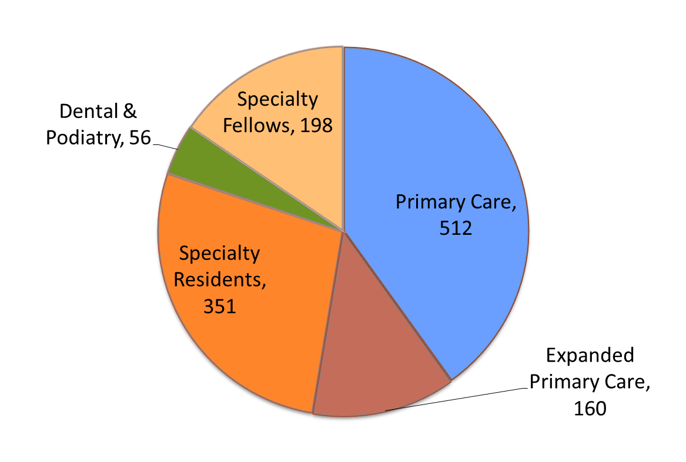
MMCGME Trainees by Specialty Category
1,275 Accredited FTEs
Primary Care includes: family medicine, general internal medicine, and general pediatrics
Expanded Primary Care includes: general surgery, psychiatry, and obstetrics

Slide 14
Minnesota Physicians by Age
Active MN licensed physicians practicing in Minnesota = 13,272
43% are age 56 or older
Age Range | Count
28-35 | 800
36-45 | 2,321
46-55 | 4,409
56-65 | 4,824
66-79 | 918
Grand Total | 13,272
Age 56 plus | 5,742
 | 43%

Slide 15
Medical Students vs. Residency Slots
Unless Congress lifts the 18 year cap on federal support for residency training, we will face a shortfall of physicians across dozens of specialties
  Students are doing their part by applying to medical school in record numbers
  Medical schools are doing their part by expanding enrollment
  Now Congress needs to do its part to expand residency training to ensure that everyone who needs a doctor has access to one

Slide 16
Residency and the Match
2013 Residency Applications
Applicants Denied
17,487 US MD 1097
2,677 US DO 658
1,487 Prev US MD 758
5,095 US Int’l 2389
7,568 Int’l 3967
34,314 TOTAL
2016 Residency Applications
21,000 US MD
6,000 US DO
27,000 TOTAL
26,000 AVAILABLE ACGME SLOTS
Sources: AAMC, AACOM, NRMP

Slide 17
GME Funding Threats
IOM Report July 29, 2014 (35% reduction)
Presidential budget recommended reducing IME by 10%
  Impact of $9 billion over 10 years
Simpson-Bowles deficit commission proposed
  Cutting IME by 60%
  Limit DGME payments to 120% of the national average salary paid to residents in 2010
  Impact of $60 billion over 10 years
Unreliable MERC Funding (Minnesota Specific Funding)
  Cut by 50% in 2011
  Restored in 2013

Slide 18
GME Value Beyond CMS
Mission
Physician workforce recruitment
Future referrals (i.e. by former trainees)
Faculty non-clinical productivity
Institutional reputation
Research
Clinical revenue
  Net clinical productivity
  Leveraged professional fees
Clinical cost savings
Patient outcomes
Education of medical students
Faculty recruitment
Address patient quality issues

Slide 19
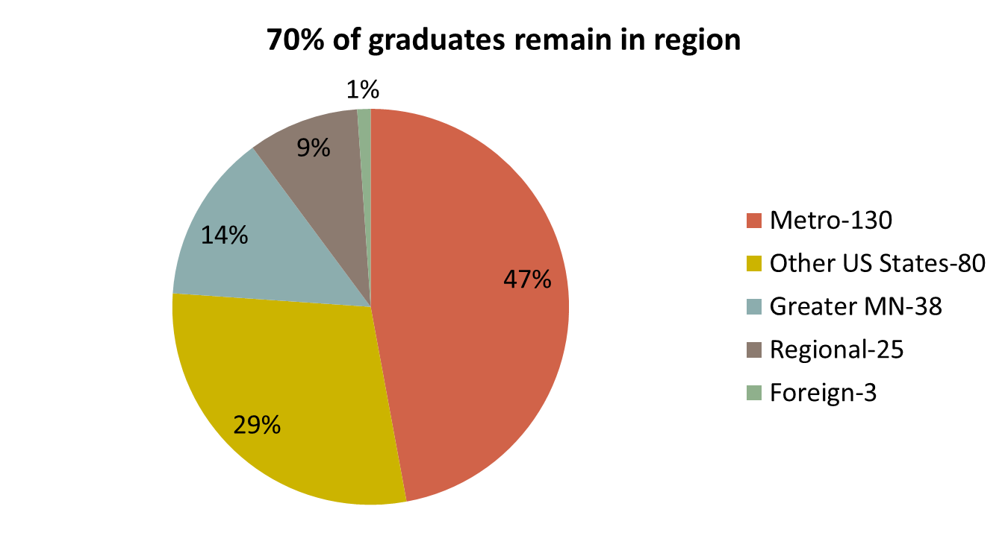
2013 MMCGME Trainee Disposition
Of graduates entering medical practice:
61% remained in MN (23% in Greater MN)
70% remained in the region

Slide 20
Summary
Retirement rate exceeds current training
GME is the bottleneck for more physicians and the training is long term.
The number of training slots funded is capped by CMS.
Funding is less than costs and is at risk.
Medical School graduates are increasing and resident slots is static.
Physicians trained in MN stay in MN.
40% of Programs are Primary Care

Slide 21
What Can Be Done
Stabilize and Increase Clinical Training Opportunities
Increase State Funding through MERC
Incentivize Primary Care Residents to work in Primary Care
Coordination of Clinical Training Sites with PA and NP
Engage other Stakeholders
  Non-Teaching Hospitals
  Practice Plans
  Business and Industry
  Health Plans

Slide 22
Questions?

